Slide 1
Chapter 6
Privacy

Slide 2
Privacy and its Values

Slide 3
Privacy
“ the claim of individuals, groups and institutions to determine for themselves, when, how and to what extent information about them is communicated to others “
PRIVACY encompasses the rights and obligations of individuals and organizations with respect to the…
Collection
Use
Disclosure, and
Retention
…of personal information.

Slide 4
Privacy
3 dimensions of privacy:
1) Personal privacy
Protecting a person against undue interference (such as physical searches) and information that violates his/her moral sense
2) Territorial privacy
Protecting a physical area surrounding a person that may not be violated without the acquiescence of the person
Safeguards: laws referring to trespassers search warrants
3) Informational privacy
Deals with the gathering, compilation and selective dissemination of information

Slide 5
Basic Privacy Principles
- Lawfulness and fairness
- Necessity of data collection and processing
- Purpose specification and purpose binding
There are no "non-sensitive" data
- Transparency
Data subject´s right to information correction, erasure or blocking of incorrect/ illegally stored data
- Supervision (= control by independent data protection authority) & sanctions
- Adequate organizational and technical safeguards

Slide 6
Privacy Protection
- Privacy and data protection laws promoted by government
- Self-regulation for fair information practices by codes of conducts promoted by businesses
- Privacy-enhancing technologies (PETs) adopted by individuals
- Privacy education of consumers and IT professionals

Slide 7
Privacy as Secrecy
Key claim is that most additional observation is illegitimate
Common in the public parlance
Not really true in most social circumstances and public places
Observation provides benefits
Observation is always a risk in public places
Some value in anonymity
Costs too…
Current expectations (reasonable or not) threatened by changing economics and politics

Slide 8
Types of Privacy
Bodily Privacy
Locational Privacy
Political Privacy
Medical Privacy
Genetic Privacy
Internet Privacy
Voter Privacy
Family Privacy
Religious Privacy
Financial Privacy
Children’s Privacy
Data Privacy
Firearms Privacy
Workplace Privacy
Travel Privacy
Postal Service Privacy
Digital Info. Privacy
Notes:
Types of privacy: Bodily privacy, locational privacy, political privacy, medical privacy, genetic privacy, Internet privacy, voter privacy, family privacy, religious privacy, financial privacy, children’s privacy, firearms privacy, workplace privacy, travel privacy, postal service privacy, and digital records privacy

Slide 9
Privacy Risks

Slide 10
Privacy Risk
- Data privacy, data security risks are not limited to financial, health care, utility sectors. Retail sector is vulnerable as well
- Breaches of data privacy, data security can result in
→ Damage to reputation
→ Disruption of operations
→ Legal liability under new and amended laws, regulations, and guidelines, as well as under contracts
→ Financial costs

Slide 11
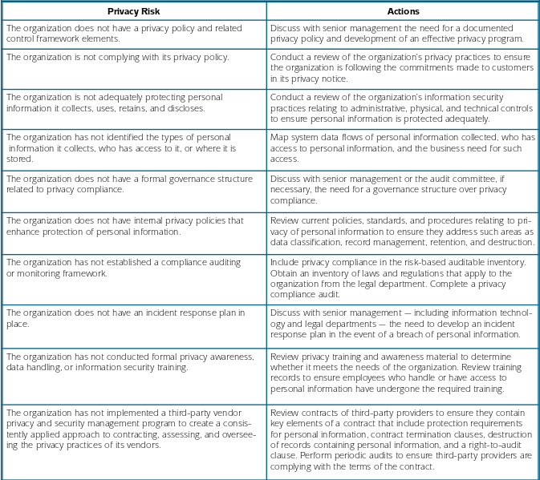

Slide 12
Privacy of Consumer Information

Slide 13
Database and Personal Records
- Data backup and storage
- Backup original data files and other essential data and software programs frequently based on data criticality, e.g., daily, weekly, monthly.
- Consider encrypting back-up disks
-Permanent copies should not be stored for archival purposes on portable device, such as laptop computers, PDAs and memory sticks.
If necessary, temporary copies could be used on portable devices, only when:
The storage is limited to the duration of the necessary use; and
If protective measures, such as encryption, are used to safeguard the confidentiality, integrity and availability of the data in the event of theft or loss.
- Transferring and downloading data
- Encryption is an important tool for protection of ePHI in transit across unsecured networks and communication systems
- Data disposal

Slide 14
Database and Personal Records
- Gathering Information:
Warranty cards.
Purchasing records.
Membership lists.
Web activity.
Change-of-address forms.
Much more….

Slide 15
Database and Personal Records
- Using Consumer Information:
Trading/buying customer lists.
Telemarketing.
Data Mining.
Mass-marketing.
Web ads.
Spam (unsolicited e-mail).

Slide 16
E-mail Privacy
What is suspicious?
- Not work-related
- Attachments not expected
- Attachments with a suspicious file extension (*.exe, *.vbs, *.bin, *.com, or *.pif)
- Web link
- Unusual topic lines; “Your car?”; “Oh!” ; “Nice Pic!”; “Family Update!”; “Very Funny!”

Slide 17
E-mail Privacy
Spamming: Unsolicited bulk e-mail, including commercial solicitations, advertisements, chain letters, pyramid schemes, and fraudulent offers.
Do not reply to spam messages. Do not spread spam. Remember, sending chain letters is against UC policy.
Do not forward chain letters. It’s the same as spamming!
Do not open or reply to suspicious e-mails.
Phishing Scams: E-Mail pretending to be from trusted names, such as Citibank or Paypal or Amazon, but directing recipients to rogue sites. A reputable company will never ask you to send your password through e-mail.
Spyware: Spyware is adware which can slow computer processing down; hijack web browsers; spy on key strokes and cripple computers

Slide 18
Web Privacy
- Be careful about providing personal, sensitive or confidential information to an Internet site or to web-based surveys that are not from trusted sources.
- Personal information posted to web-pages may not be protected from unauthorized use.
- Even unlinked web pages can be found by search engines
- Some web sites try to place small files (“cookies”) on your computer that might help others track the web pages you access

Slide 19
Protecting Privacy

Slide 20
Fraud
- The crime of obtaining money or some other benefit by deliberate deception.
- Most common forms of IT fraud
→ Identity theft
→ Credit card fraud
→ Scammers and con artists
→ Financial swindles

Slide 21
Protecting online Privacy
- Implement appropriate security measures
- Get a copy of your credit report
Use:
→ Junk e-mail account
→ Anonymous remailer
→ Stealth surfing service
→ Common sense
→ Deal with recognized, trusted e-retailers
→ Keep important numbers and passwords secret
→ Use good passwords
→ If your computer acts strangely, find out why

Slide 22
Offensive Speech and Censorship in Cyberspace

Slide 23
Offensive Speech and censorship in cyberspace
Speech Might Include:
- Political or religious speech.
- Pornography.
- Sexual or racial slurs.
- Nazi materials.
- Libelous statements.
- Abortion information.
- Alcohol ads.

Slide 24
Offensive Speech and censorship in cyberspace
Material is considered obscene if all three parts are met:
1. It depicts sexual (or excretory) acts whose depiction is specifically prohibited by state law, and
2. It depicts these acts in a patently offensive manner, appealing to the prurient interest as judged by a reasonable person using community standards, and
3. It has no serious literary, artistic, social, political, or scientific value.

Slide 25
Offensive Speech and censorship in cyberspace
Material Inappropriate for Children:
- Technology Changes the Context
*On the Web, children have access to the same ‘adult’ text, images, videos, etc. as adults.
*Online proprietors don’t know the customer is not an adult.
- Protecting Children
Regardless of the medium:
*It is illegal to create, possess or distribute child pornography.
*It is illegal to lure children into sexual activity

Slide 26
Offensive Speech and censorship in cyberspace
Limiting Internet Access in Libraries and Schools
Filtering Software
- Benefit: prevent access to inappropriate material on the Internet by screening words or phrases, blocking sites according to rating system, or disallowing access to specific sites in a list.
- Problems: can be ineffective—kids get around the filters; the words, phrases, rating systems, etc. are subjective; “banned” keywords can be overly restrictive for adult users and for legitimate use by minors.

Slide 27
Offensive Speech and censorship in cyberspace
Censorship On the Global Net
Global Impact
- Avoiding censorship: the global nature of the Net allows restrictions (or barriers) in one country to be circumvented by using networks in other, less restrictive countries.
- Creating censorship: the global nature of the Net makes it easier for one nation to impose restrictive standards on others

Slide 28
Anonymity

Slide 29
Anonymity
- Early publications by some of our Founding Fathers were published under pseudonyms.
- Today, there are publications on the Net that are posted anonymously
- Anonymity protects against retaliation and embarrassment.
- Supporters of anonymity: Say it is necessary to protect privacy and free speech.
- Opponents of anonymity: Believe it is anti-social and allows criminals to hide from law enforcement.

